Slide 1
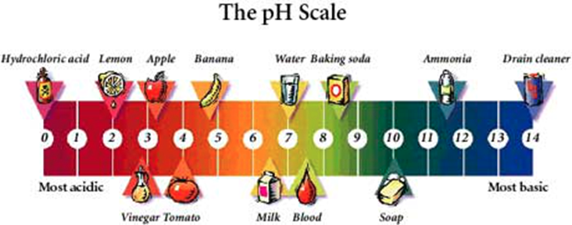
Solutions, Solubility and Acids and Bases

Slide 2
Three Kinds of Mixtures
1. A solution is an evenly-mixed mixture where you can’t see its different parts. Solutions have the same properties throughout.
They can be in solid, liquid or gas form. Acids and bases are solutions.
solid ex : _______________________________
liquid ex: _______________________________
gas ex: ________________________________
All solutions have 2 parts:
A. The solvent is the larger part of a solution and it dissolves the solute (water in saltwater).
B. The solute is the smaller part of a solution and it is what gets dissolved (salt in saltwater).
Homogeneous or heterogeneous?

Slide 3
Colloids and Suspensions
2. A colloid is a mixture that contains small, undissolved particles dispersed throughout another substance.
Ex: milk, fog, mayonnaise, spray paint, jello, ice cream,
Colloid particles are larger than solution particles, so some colloids can scatter light.
3. A suspension is a mixture in which the particles are large enough to be seen. Particles are easily removed by filtering
Ex: orange juice with pulp, ocean water, dust in the air, a snow globe.
Classify: homogeneous - __________ heterogeneous - ___________

Slide 4
Solutions: Effects of Solutes on Solvents
Solutes ________ the freezing points and _______ the boiling points of solvents.
Example #1. Using salt to melt ice. Pure water freezes at 0° Celsius, but adding CaCl₂ salt can lower freezing temp. to -25°.
Example #2. Antifreeze in a car has very high boiling point so engine won’t overheat, and very low freezing point so engine doesn’t freeze in cold temps.

Slide 5
Section One – Understanding Solutions
1. A. What is a solution? B. In a solution of two liquids, where you have 30ml of liquid A and 35 ml of liquid B, which liquid is the solvent and which is the solute? Why?
2. A. Are all solutions liquids? B. Generate three different examples of solutions, each one in a different state of matter. (Please come up with examples not discussed in class or in your notes)
3. A. What are three differences between a suspension and a colloid? B. Give one example of a suspension and one example of a colloid.
4. A. What effects do solutes have on the freezing and boiling points of solvents? B. Why is the temperature needed to freeze the Great Salt Lake in Utah water lower than the temperature needed to freeze Nevada’s freshwater Lake Mead?
5. Classify the following as either a solution (sl), suspension (sp), or colloid (c):
lemonade: ___ sodium hydroxide (strong base -NaOH): ____ hair spray: ____ vegetable soup: ____
shaving cream: ____ oil and water: ____ a brass trumpet: ____ gasoline: _____ sulfuric acid (H₂SO₄): ____

Slide 6
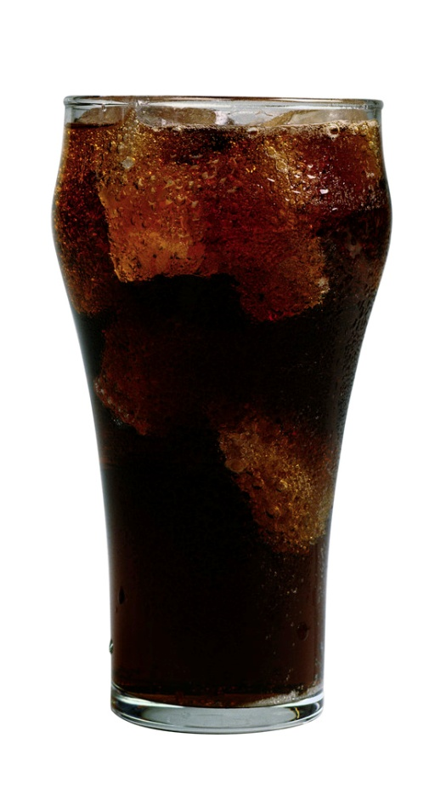
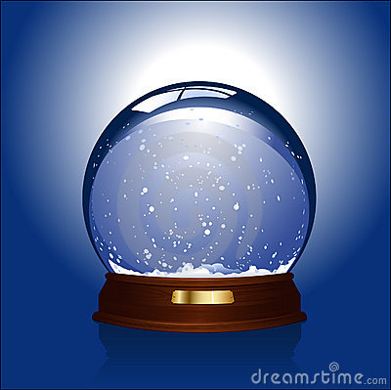
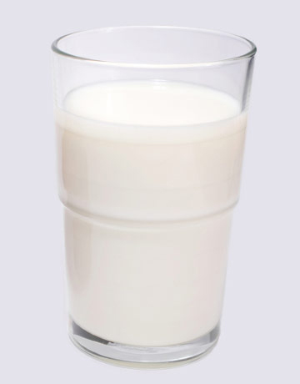
Identify the Mixtures

Slide 7
Concentration and Solubility
The concentration of a solution compares the amount of solute to the amount of solvent.
It can be expressed as a ratio or a percentage.
Ex. #1: Sugar in 1 can of Coke: 39 g sugar / 355 ml of soda
Ex #2: Sodium hypochlorite (NaClO) in Clorox Bleach: 6%
Diluted solution = low ratio of solute/solvent
Concentrated solution = high ratio solute/solvent
A solution’s concentration is changed by adding either solute or solvent.
Adding solute = ___________ concentrated solution
Adding solvent = _______________ diluted solution

Slide 8
Solubility
Solubility is the measure of how much solute can dissolve in a solvent at a given temperature. It’s a __________ property.
Example: 120 grams of glucose will dissolve into 100 ml of water, at 30° C.
Solubility changes based on three factors:
1. Temperature: more heat = more dissolving.
2. Pressure: more pressure = more dissolving
3. Type of solvent – ‘like dissolves like’. Water will dissolve ionic and polar compounds. Nonpolar compounds (oil) do not dissolve in polar solvents.

Slide 9
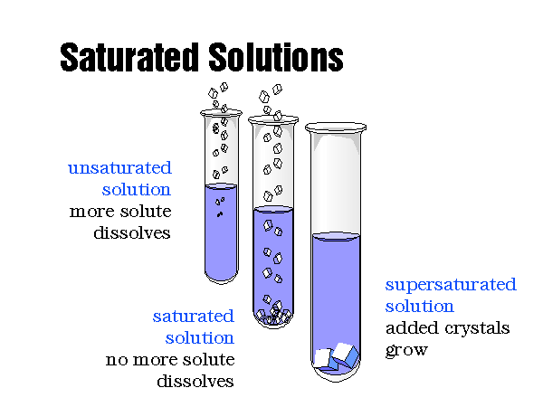

Slide 10
Saturated/Unsaturated/Supersaturated
A saturated solution is a solution that has so much solute that no more solute will dissolve.
An unsaturated solution is a solution that can still dissolve more solute.
A supersaturated solution has more dissolved solute than is predicted by its solubility at a given temperature.
Ex: rock candy, seltzer

Slide 11
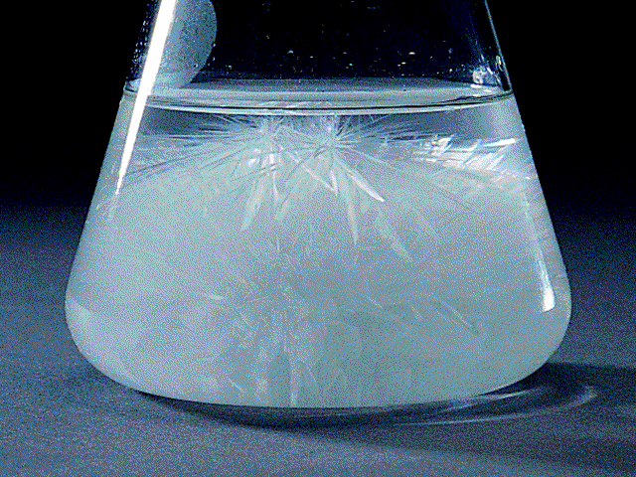
Supersaturated Solution

Slide 12
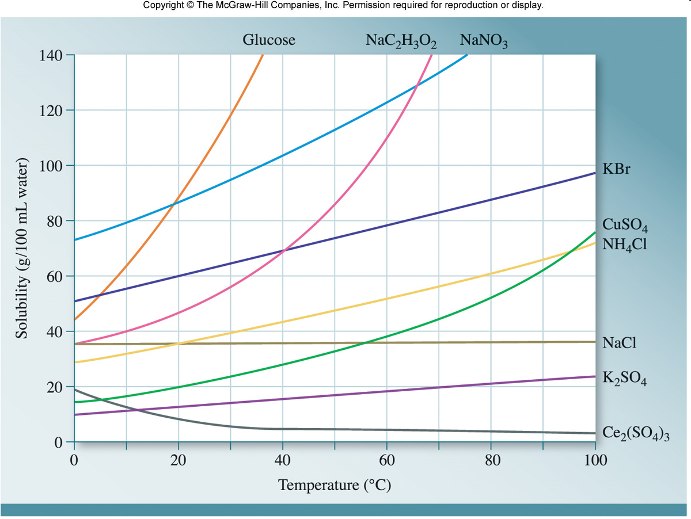

Slide 13
Section Two – Concentration and Solubility
6. Your friend adds an unknown amount of powdered Gatorade mix to a large container of water. You taste the mixture and can hardly detect any flavor. A. Would this Gatorade mixture be classified as a diluted or concentrated solution? B. How could you make it taste better? (Use the terms solute, solvent, and concentration in this answers.
7. Which solution has a higher concentration and why? 14 g salt/50 ml water or 98 g salt/175 ml water?
8. Your make a pitcher of iced tea, but after tasting it, you realize that it needs to be sweeter. You are successfully able to dissolve two spoonfuls of sugar into the iced tea, but as soon as you add a third spoonful, you notice that it sinks to the bottom of the pitcher, undissolved.
A. What term can be used to describe the iced tea after one spoonful of sugar is added?
B. What term describes the iced tea after two spoonfuls of sugar are added?
C. What could you do to the iced tea to allow more sugar to be dissolved. What physical property of the iced tea would you increase by doing this?
9. A. What is a supersaturated solution? B. Explain why a sealed can of seltzer is considered a supersaturated solution and why it bubbles up as soon as the can is opened.

Slide 14
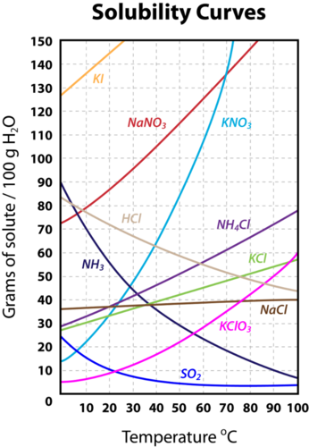
10. How much sodium nitrate can be dissolved into 100 ml of water at 40°C?
11. Describe the solubility of 50 grams potassium chloride.
12. Can you dissolve 80 grams of hydrochloric acid into 100 ml of water at 30°C? Why or why not? What happens to the solubility of this acid as temperature increases?
13. At what temperature can you dissolve exactly 10 grams of sulfur dioxide into 100 ml of water?

Slide 15
Acids, Bases and pH
The pH scale describes the strength of acids and bases.
pH (potential Hydrogen) measures the concentration of hydrogen ions (H⁺) in any acid or base.
The lower the pH, the ___________ the concentration of H⁺ ions
0 - 7 = acid
7 - 14 = base
Exactly 7 = neutral

Slide 16
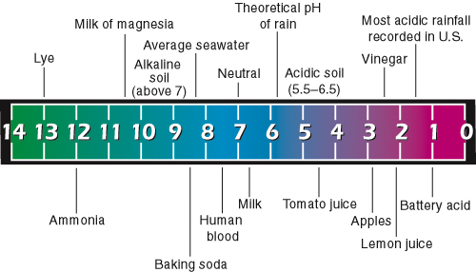
pH Scale

Slide 17
Properties of Acids
Sour taste (citrus fruits).
React with metals and carbonates
They are corrosive - eat away at metals – and produce H₂ gas
Turns blue Litmus paper red
Litmus paper is an indicator - a compound that changes color when it comes into contact with an acid or a base.
pH paper is a more precise indicator, and it determines the exact pH level of a substance

Slide 18
Acids in Solutions
An acid is any substance that produces hydrogen ions (H+) in water.
The more hydrogen ions an acid has, the stronger it is, and _________ its pH
Many acids have formulas that begin with hydrogen.
Common acids:
HCl – hydrochloric acid
H₂SO₄ – sulfuric acid
HNO₃ – nitric acid

Slide 19
Bases in Solutions
A base is any substance that produces hydroxide ions (OH-) in water.
The hydroxide ion is made of oxygen and hydrogen and it has a negative charge.
The more hydroxide ions a base has, the stronger it is.
Common bases:
NaOH – sodium hydroxide
NH₃ – ammonia

Slide 20
Properties of Bases
Bitter taste.
Feels slippery (soap, shampoo, detergent).
Turns red Litmus paper blue.
React with metals but not carbonates.
React with acids.

Slide 21
Acid-Base Reactions
Neutralization is a reaction where an acid reacts with a base to produce a salt and water.
The resulting solution is not as acidic or as basic as it was in the beginning.
A salt is an ionic compound that is made from the positive ion of the base and the negative ion of the acid during a neutralization reaction.

Slide 22
Section Three -- Describing Acids and Bases
14. List three different properties of acids and three different properties of bases
Acids Bases
1. 1.
2. 2.
3. 3.
15. Using the Acids/Bases Chart in Chapter Three, Section Three of your text book:
Complete the chart below by listing three different uses of acids (substances/products/foods in which acids are found), AND which acid is present in each case?
Complete the second chart by listing three different uses of bases (substances/products/foods in which bases are found), AND which base is present in each case?
Acid-containing Substance, Food or Product | Name and Chem. Formula of This Acid
1.
2.
3.
Base-containing Substance, Food or Product | Name and Chem. Formula of This Base
1.
2.
3.

Slide 23
Section Four -- Acids and Bases in Solution
16. What kind of ions do acids form in aqueous solutions? Bases?
17. A. Where are the pH ranges for acids, bases, and neutral solutions? B. What does the pH scale actually measure?
18. If a solution has a pH of 5, would this solution contain fewer or more hydrogen ions (H⁺) than an equal volume of solution with a pH of 2? Why?
19. Between Litmus paper and pH paper, which indicator is more accurate and why?
20. Describe a neutralization reaction between the base NaOH (sodium hydroxide) and the acid HNO₃ (nitric acid). What would the products of this reaction be?

